Slide 1
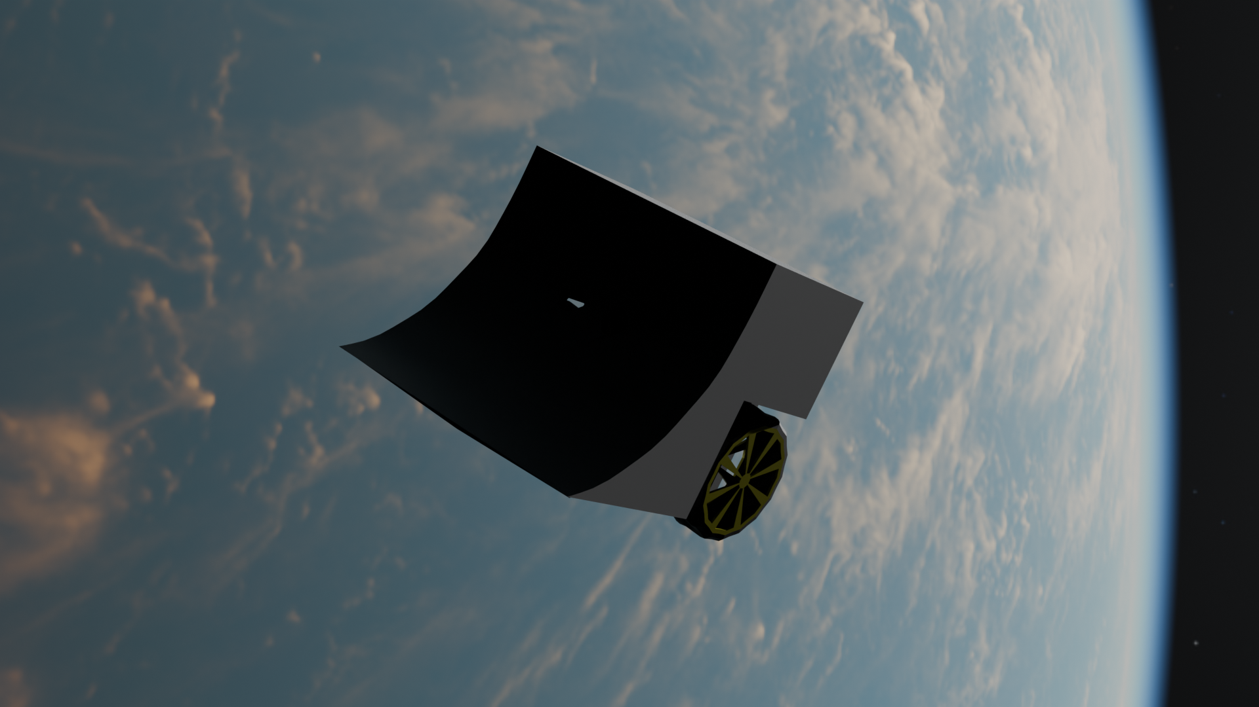
Bus robot
Made by Les fous du bus:
- Maël B.
- Gabriel L.
- Robin P.
visuals made in blender without ai

Slide 2
The robot club
In this club we...
...imagine
...design
...code
...assemble
robots from scratch, 2h a week

Slide 3
The strategy
Our robot is offensive:

